Slide 1
Qin Shi Huang’s National Road System
Uva 1494, Beijing 2011, LA 5713
3 seconds

Slide 2
Problem Descriptions(1/3)
During the Warring States Period of ancient China (476 BC to 221 BC), there were seven kingdoms in China — they were Qi, Chu, Yan, Han, Zhao, Wei and Qin. Ying Zheng was the king of the kingdom Qin. Through 9 years of wars, he finally conquered all six other kingdoms and became the first emperor of a unified China in 221 BC.
That was Qin dynasty — the first imperial dynasty of China(not to be confused with the Qing Dynasty, the last dynasty of China). So Ying Zheng named himself ”Qin Shi Huang” because ”Shi Huang” means ”the first emperor ” in Chinese.

Slide 3
Problem Descriptions(2/3)
Qin Shi Huang undertook gigantic projects, including the first version of the Great Wall of China, the now famous city sized mausoleum guarded by a life-sized Terracotta Army, and a massive national road system.
There is a story about the road system:
There were n cities in China and Qin Shi Huang wanted them all be connected by n − 1 roads, in order that he could go to every city from the capital city Xian Yang. Although Qin Shi Huang was a tyrant, he wanted the total length of all roads to be minimum, so that the road system may not cost too many people’s life.

Slide 4
Problem Descriptions(3/3)
A daoshi (some kind of monk) named Xu Fu told Qin Shi Huang that he could build a road by magic and that magic road would cost no money and no labor. But Xu Fu could only build ONE magic road for Qin Shi Huang. So Qin Shi Huang had to decide where to build the magic road. Qin Shi Huang wanted the total length of all none magic roads to be as small as possible, but Xu Fu wanted the magic road to benefit as many people as possible.
So Qin Shi Huang decided that the value of A/B (the ratio of A to B) must be the maximum
A is the total population of the two cites connected by the magic road
B is the total length of none magic roads.

Slide 5
Input
The first line contains an integer t meaning that there are t test cases (t ≤ 10).
For each test case:
The first line is an integer n meaning that there are n cities (2 < n ≤ 1000). Then n lines follow.
Each line contains three integers X, Y and P (0 ≤ X, Y ≤ 1000, 0 < P < 100000).
(X, Y ) is the coordinate of a city.
P is the population of that city.
It is guaranteed that each city has a distinct location.

Slide 6
Output
For each test case, print a line indicating the above mentioned maximum ratio A/B.
The result should be rounded to 2 digits after decimal point.

Slide 7

Example
Num of test cases
Num of cities
2
4
1 1 20
1 2 30
200 2 80
200 1 100
3
1 1 20
1 2 30
2 2 40
65.00
70.00
coordidate
population
130/2=65.00
(1,2,30)
(200,2,80)
1
1
(1,1,20)
(200,1,100)
70/1=70.00
(1,2,30)
(2,2,40)
1
(1,1,20)

Slide 8
Kruskal’s Algorithm
Answer: Minimum Cost=46
Sort Edges:
2
3
4
5
6
8
9
10
14
15
A
6
4
H
5
B
9
C
14
2
10
G
E
15
D
3
8
F

Slide 9
Kruskal’s Algorithm
Kruskal’s Algorithm( G(V,E) )
{ T← ∅
While |T|<|V|-1 and E≠ ∅
{ ExtraxtMin (v,w) from E
If(v,w)doesn’t cause cycle in T
then add (v,w) to T
else discard (v,w)
}
}

Slide 10
Disjoint-Set Union Problem
Disjoint sets , S_{i} ∩ S_{j} = ∅
Need to support following operations:
MakeSet(x): S={x}
Union(S_{i}, S_{j}): {S_{i} U S_{j}}
FindSet(x): return S, such that x ∈ S

Slide 11
Kruskal’s Algorithm
Kruskal()
{
T = ∅;
for each v ∈ V
MakeSet(v);
sort E by increasing edge weight w
for each (u,v) ∈ E (in sorted order)
if FindSet(u) ≠ FindSet(v)
T = T U {(u,v)};
Union(FindSet(u), FindSet(v));
}

Slide 12
Kruskal’s Algorithm
Kruskal()
{
T = ∅;
for each v ∈ V
MakeSet(v);
sort E by increasing edge weight w
for each (u,v) ∈ E (in sorted order)
if FindSet(u) ≠ FindSet(v)
T = T U {{u,v}};
Union(FindSet(u), FindSet(v));
}
2
19
9
14
17
8
25
5
21
13
1

Slide 13
Kruskal’s Algorithm
Kruskal()
{
T = ∅;
for each v ∈ V
MakeSet(v);
sort E by increasing edge weight w
for each (u,v) ∈ E (in sorted order)
if FindSet(u) ≠ FindSet(v)
T = T U {(u,v)};
Union(FindSet(u), FindSet(v));
}
2
19
9
14
17
8
25
5
21
13
1

Slide 14
Kruskal’s Algorithm
Kruskal()
{
T = ∅;
for each v ∈ V
MakeSet(v);
sort E by increasing edge weight w
for each (u,v) ∈ E (in sorted order)
if FindSet(u) ≠ FindSet(v)
T = T U {(u,v)};
Union(FindSet(u), FindSet(v));
}
2
19
9
14
17
8
25
5
21
13
1

Slide 15
Kruskal’s Algorithm
Kruskal()
{
T = ∅;
for each v ∈ V
MakeSet(v);
sort E by increasing edge weight w
for each (u,v) ∈ E (in sorted order)
if FindSet(u) ≠ FindSet(v)
T = T U {(u,v)};
Union(FindSet(u), FindSet(v));
}
2
19
9
14
17
8
25
5
v
21
13
1
u

Slide 16
Kruskal’s Algorithm
Run the algorithm:
Kruskal()
{
T = ∅;
for each v ∈ V
MakeSet(v);
sort E by increasing edge weight w
for each (u,v) ∈ E (in sorted order)
if FindSet(u) ≠ FindSet(v)
T = T U {(u,v)};
Union(FindSet(u), FindSet(v));
}
2
19
9
14
17
8
25
5
21
13
1

Slide 17
Kruskal’s Algorithm
Run the algorithm:
Kruskal()
{
T = ∅;
for each v ∈ V
MakeSet(v);
sort E by increasing edge weight w
for each (u,v) ∈ E (in sorted order)
if FindSet(u) ≠ FindSet(v)
T = T U {(u,v)};
Union(FindSet(u), FindSet(v));
}
u
2
v
19
9
14
17
8
25
5
21
13
1

Slide 18
Kruskal’s Algorithm
Kruskal()
{
T = ∅;
for each v ∈ V
MakeSet(v);
sort E by increasing edge weight w
for each (u,v) ∈ E (in sorted order)
if FindSet(u) ≠ FindSet(v)
T = T U {(u,v)};
Union(FindSet(u), FindSet(v));
}
2
19
9
14
17
8
25
5
21
13
1

Slide 19
Kruskal’s Algorithm
Kruskal()
{
T = ∅;
for each v ∈ V
MakeSet(v);
sort E by increasing edge weight w
for each (u,v) ∈ E (in sorted order)
if FindSet(u) ≠ FindSet(v)
T = T U {(u,v)};
Union(FindSet(u), FindSet(v));
}
u
2
19
9
14
17
8
25
5
21
13
1
v

Slide 20
Kruskal’s Algorithm
Kruskal()
{
T = ∅;
for each v ∈ V
MakeSet(v);
sort E by increasing edge weight w
for each (u,v) ∈ E (in sorted order)
if FindSet(u) ≠ FindSet(v)
T = T U {(u,v)};
Union(FindSet(u), FindSet(v));
}
2
19
9
14
17
8
25
5
21
13
1

Slide 21
Kruskal’s Algorithm
Kruskal()
{
T = ∅;
for each v ∈ V
MakeSet(v);
sort E by increasing edge weight w
for each (u,v) ∈ E (in sorted order)
if FindSet(u) ≠ FindSet(v)
T = T U {(u,v)};
Union(FindSet(u), FindSet(v));
}
u
2
19
9
14
17
8
25
5
v
21
13
1

Slide 22
Kruskal’s Algorithm
Kruskal()
{
T = ∅;
for each v ∈ V
MakeSet(v);
sort E by increasing edge weight w
for each (u,v) ∈ E (in sorted order)
if FindSet(u) ≠ FindSet(v)
T = T U {(u,v)};
Union(FindSet(u), FindSet(v));
}
2
19
9
14
17
8
25
5
21
13
1

Slide 23
Kruskal’s Algorithm
Kruskal()
{
T = ∅;
for each v ∈ V
MakeSet(v);
sort E by increasing edge weight w
for each (u,v) ∈ E (in sorted order)
if FindSet(u) ≠ FindSet(v)
T = T U {(u,v)};
Union(FindSet(u), FindSet(v));
}
2
19
u
9
v
14
17
8
25
5
21
13
1

Slide 24
Kruskal’s Algorithm
Kruskal()
{
T = ∅;
for each v ∈ V
MakeSet(v);
sort E by increasing edge weight w
for each (u,v) ∈ E (in sorted order)
if FindSet(u) ≠ FindSet(v)
T = T U {(u,v)};
Union(FindSet(u), FindSet(v));
}
2
19
9
14
17
8
25
5
u
v
21
13
1

Slide 25
Kruskal’s Algorithm
Kruskal()
{
T = ∅;
for each v ∈ V
MakeSet(v);
sort E by increasing edge weight w
for each (u,v) ∈ E (in sorted order)
if FindSet(u) ≠ FindSet(v)
T = T U {(u,v)};
Union(FindSet(u), FindSet(v));
}
2
19
9
14
17
8
25
5
21
13
1

Slide 26
Kruskal’s Algorithm
Run the algorithm:
Kruskal()
{
T = ∅;
for each v ∈ V
MakeSet(v);
sort E by increasing edge weight w
for each (u,v) ∈ E (in sorted order)
if FindSet(u) ≠ FindSet(v)
T = T U {(u,v)};
Union(FindSet(u), FindSet(v));
}
2
19
u
9
14
17
8
25
v
5
21
13
1

Slide 27
Kruskal’s Algorithm
Kruskal()
{
T = ∅;
for each v ∈ V
MakeSet(v);
sort E by increasing edge weight w
for each (u,v) ∈ E (in sorted order)
if FindSet(u) ≠ FindSet(v)
T = T U {(u,v)};
Union(FindSet(u), FindSet(v));
}
2
19
9
14
17
8
25
5
21
13
1

Slide 28
Kruskal’s Algorithm
Kruskal()
{
T = ∅;
for each v ∈ V
MakeSet(v);
sort E by increasing edge weight w
for each (u,v) ∈ E (in sorted order)
if FindSet(u) ≠ FindSet(v)
T = T U {{u,v}};
Union(FindSet(u), FindSet(v));
}
2
19
v
9
14
17
8
25
5
u
21
13
1

Slide 29
Kruskal’s Algorithm
Kruskal()
{
T = ∅;
for each v ∈ V
MakeSet(v);
sort E by increasing edge weight w
for each (u,v) ∈ E (in sorted order)
if FindSet(u) ≠ FindSet(v)
T = T U {{u,v}};
Union(FindSet(u), FindSet(v));
}
2
u
19
v
9
14
17
8
25
5
21
13
1

Slide 30
Kruskal’s Algorithm
Kruskal()
{
T = ∅;
for each v ∈ V
MakeSet(v);
sort E by increasing edge weight w
for each (u,v) ∈ E (in sorted order)
if FindSet(u) ≠ FindSet(v)
T = T U {{u,v}};
Union(FindSet(u), FindSet(v));
}
2
19
9
14
17
8
25
5
u
v
21
13
1

Slide 31
Kruskal’s Algorithm
Kruskal()
{
T = ∅;
for each v ∈ V
MakeSet(v);
sort E by increasing edge weight w
for each (u,v) ∈ E (in sorted order)
if FindSet(u) ≠ FindSet(v)
T = T U {{u,v}};
Union(FindSet(u), FindSet(v));
}
2
19
u
9
14
17
8
25
5
v
21
13
1

Slide 32
Kruskal’s Algorithm
Kruskal()
{
T = ∅;
for each v ∈ V
MakeSet(v);
sort E by increasing edge weight w
for each (u,v) ∈ E (in sorted order)
if FindSet(u) ≠ FindSet(v)
T = T U {{u,v}};
Union(FindSet(u), FindSet(v));
}
2
19
9
14
17
8
25
5
21
13
1

Slide 33
Kruskal’s Algorithm
Kruskal()
{
T = ∅;
for each v ∈ V
MakeSet(v);
sort E by increasing edge weight w
for each (u,v) ∈ E (in sorted order)
if FindSet(u) ≠ FindSet(v)
T = T U {{u,v}};
Union(FindSet(u), FindSet(v));
}
What is the running time?

Slide 34
Kruskal’s Algorithm
What is the running time?
Kruskal()
{
T = ∅;
for each v ∈ V
MakeSet(v);
sort E by increasing edge weight w
for each (u,v) ∈ E (in sorted order)
if FindSet(u) ≠ FindSet(v)
T = T U {{u,v}};
Union(FindSet(u), FindSet(v));
}
1 Sort
O(V) MakeSet() calls
O(E) FindSet() calls O(V) Union() calls

Slide 35
Kruskal’s Algorithm: Running Time
To summarize:
Sort edges: O(E lg E)
O(V) MakeSet()’s
O(E) FindSet()’s
O(V) Union()’s
Upshot:
Overall thus O(E lg E)

Slide 36
Solution
Minimum Spanning Tree, W.
Use DFS to find the maximum segment k from any vertex u to vertex v in MST.
Find maximum
A/B = (P(u)+P(v)) / (W-k)

Slide 37
Example
100
1
20
10
30
18
25
2
80
3
15
30
16
12
22
35
20
4
5
13
50

Slide 38
Example
10+12+13+20=55
100
1
20
10
30
18
25
2
80
3
30
16
12
22
35
20
4
5
13
50

Slide 39
Example
A/B=(100+30)/(55-20)
=3.17
10+12+13+20=55
100
1
20
10

30
18
25
2
80
3
30
16
12
22
35
20
4
5
13
50

Slide 40
Example
A/B=(80+30)/(55-20)
=3.14
10+12+13+20=55
100
1
20
10

30
18
25
2
80
3
30
16
12
22
35
20
4
5
13
50

Slide 41
Example
A/B=(30+20)/(55-20)
=1.42
10+12+13+20=55
100
1
20
10

30
18
25
2
80
3
30
16
12
22
35
20
4
5
13
50

Slide 42
Example
A/B=(30+50)/(55-20)
=2.28
10+12+13+20=55
100
1
20
10

30
18
25
2
80
3
30
16
12
22
35
20
4
5
13
50

Slide 43
Example
A/B=(100+80)/(55-10)
=4.00
10+12+13+20=55
100
1

20
10
30
18
25
2
80
3
30
16
12
22
35
20
4
5
13
50

Slide 44
Example
A/B=(100+20)/(55-12)
=2.79
10+12+13+20=55
100
1
20
10
30
18
25
2
80
3

30
16
12
22
35
20
4
5
13
50

Slide 45
Example
A/B=(100+50)/(55-13)
=3.57
10+12+13+20=55
100
1
20
10
30
18
25
2
80
3
30
16
12
22
35
20
4

5
13
50

Slide 46
Example
A/B=(80+20)/(55-12)
=2.32
10+12+13+20=55
100
1
20
10
30
18
25
2
80
3

30
16
12
22
35
20
4
5
13
50

Slide 47
Example
A/B=(80+50)/(55-13)
=3.09
10+12+13+20=55
100
1
20
10
30
18
25
2
80
3
30
16
12
22
35
20
4

5
50
13

Slide 48
Example
A/B=(20+50)/(55-13)
=1.66
10+12+13+20=55
100
1
20
10
30
18
25
2
80
3
30
16
12
22
35
20
4

5
50
13

Slide 49
Example
A/B=(100+80)/(55-10)
=4.00
10+12+13+20=55
100
1

20
10
30
18
25
2
80
3
30
16
12
22
35
20
4
5
13
50

Slide 50
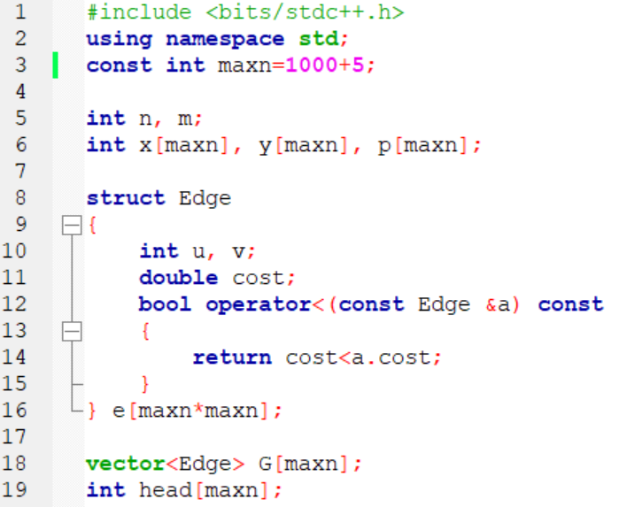

Slide 51
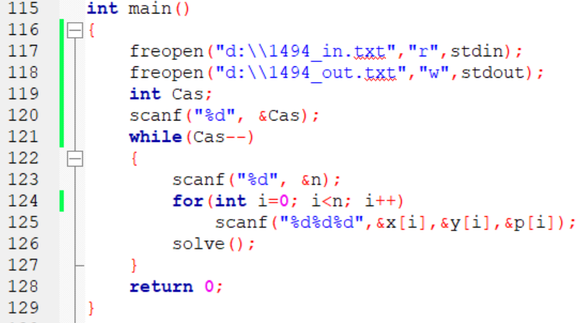
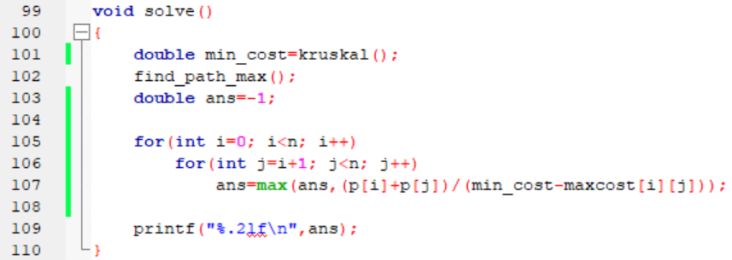

Slide 52
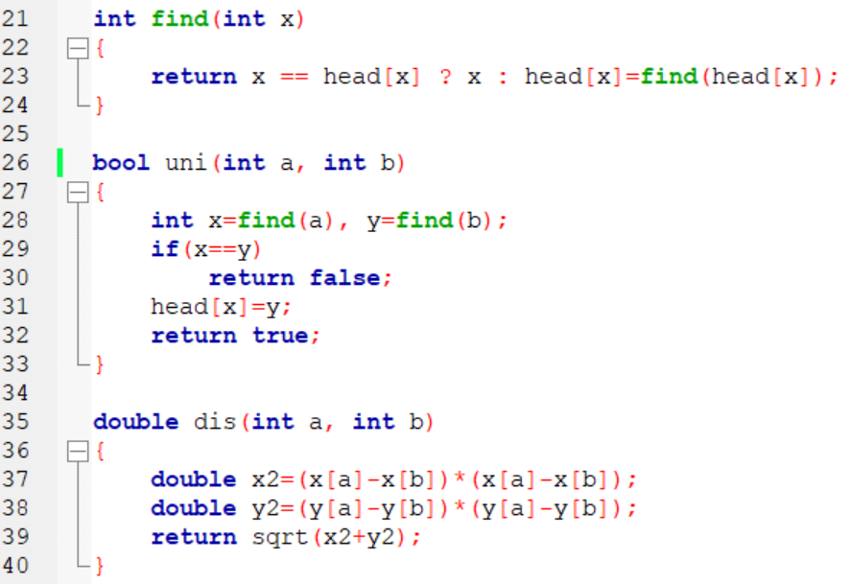

Slide 53
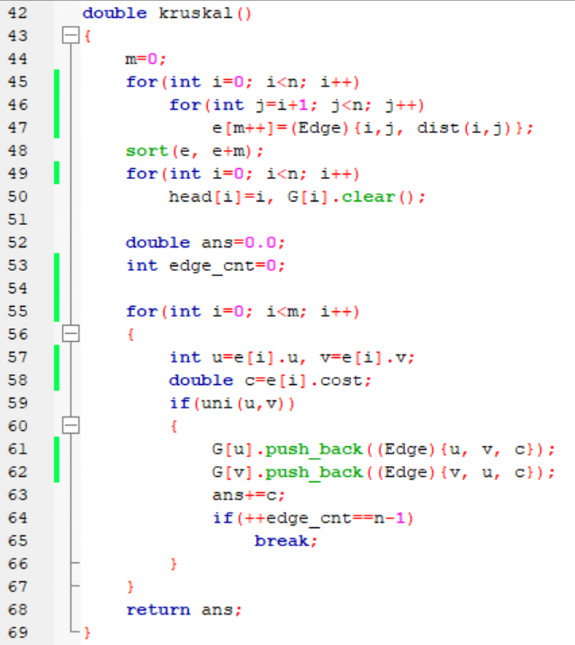
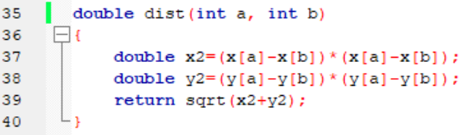

Slide 54
